Slide 1
ScalaZ vs Cats

Slide 2
CONTENTS
Why we need to use some functional libraries?
What is the difference between Cats and Scalaz?
Comparison
History of Cats and Scalaz
Real life example

Slide 3
Why we need to use some functional libraries?
Isn’t Scala already a functional language?
Scala is already functional, but a lot of the machinery for doing pure functional programming is missing in the standard library. Plenty of people do heavy FP without Scalaz or Cats, but eventually you may find yourself reinventing some of the things those libraries provide.
Mutable variables as first-class citizens of the language
Uncontrolled side-effects (ties in with the first point)
Mutable collections and other imperative libraries exist on equal footing
Object-oriented structures (class inheritance, overloading, etc)
Verbosity

Slide 4
What is the difference between Cats and Scalaz?
Cats and Scalaz have the same goal: to facilitate pure functional programming in Scala applications.
Scalaz or Cats are libraries, think of them like a swiss army knife. You may only need one or two core data structures, or you may want to use tons of them, it really depends on the problem. My gateway drug into using Scalaz was needing to easily work with Future[Option[String]] types, without having to nest maps. Those are called Monad Transformers, and make life easier.

Slide 5
More about Cats Goals
Small
Modular
Friendly to newcomers
Efficient
Not willing to compromise on Principals
Willing to compromise on Principals
Clean, consistent source code
Everything is serializable
Scaladoc all the thing

Slide 6
Comparison
ScalaZ
Started: 2009
Cats:
Started: 2015
Project | Releases | Watchers | Stars | Forks | Commits | Prev. Month Commits
Scalaz | 128 | 276 | 4030 | 680 | 6523 | 8
Cats | 35 | 206 | 3024 | 764 | 3878 | 82

Slide 7
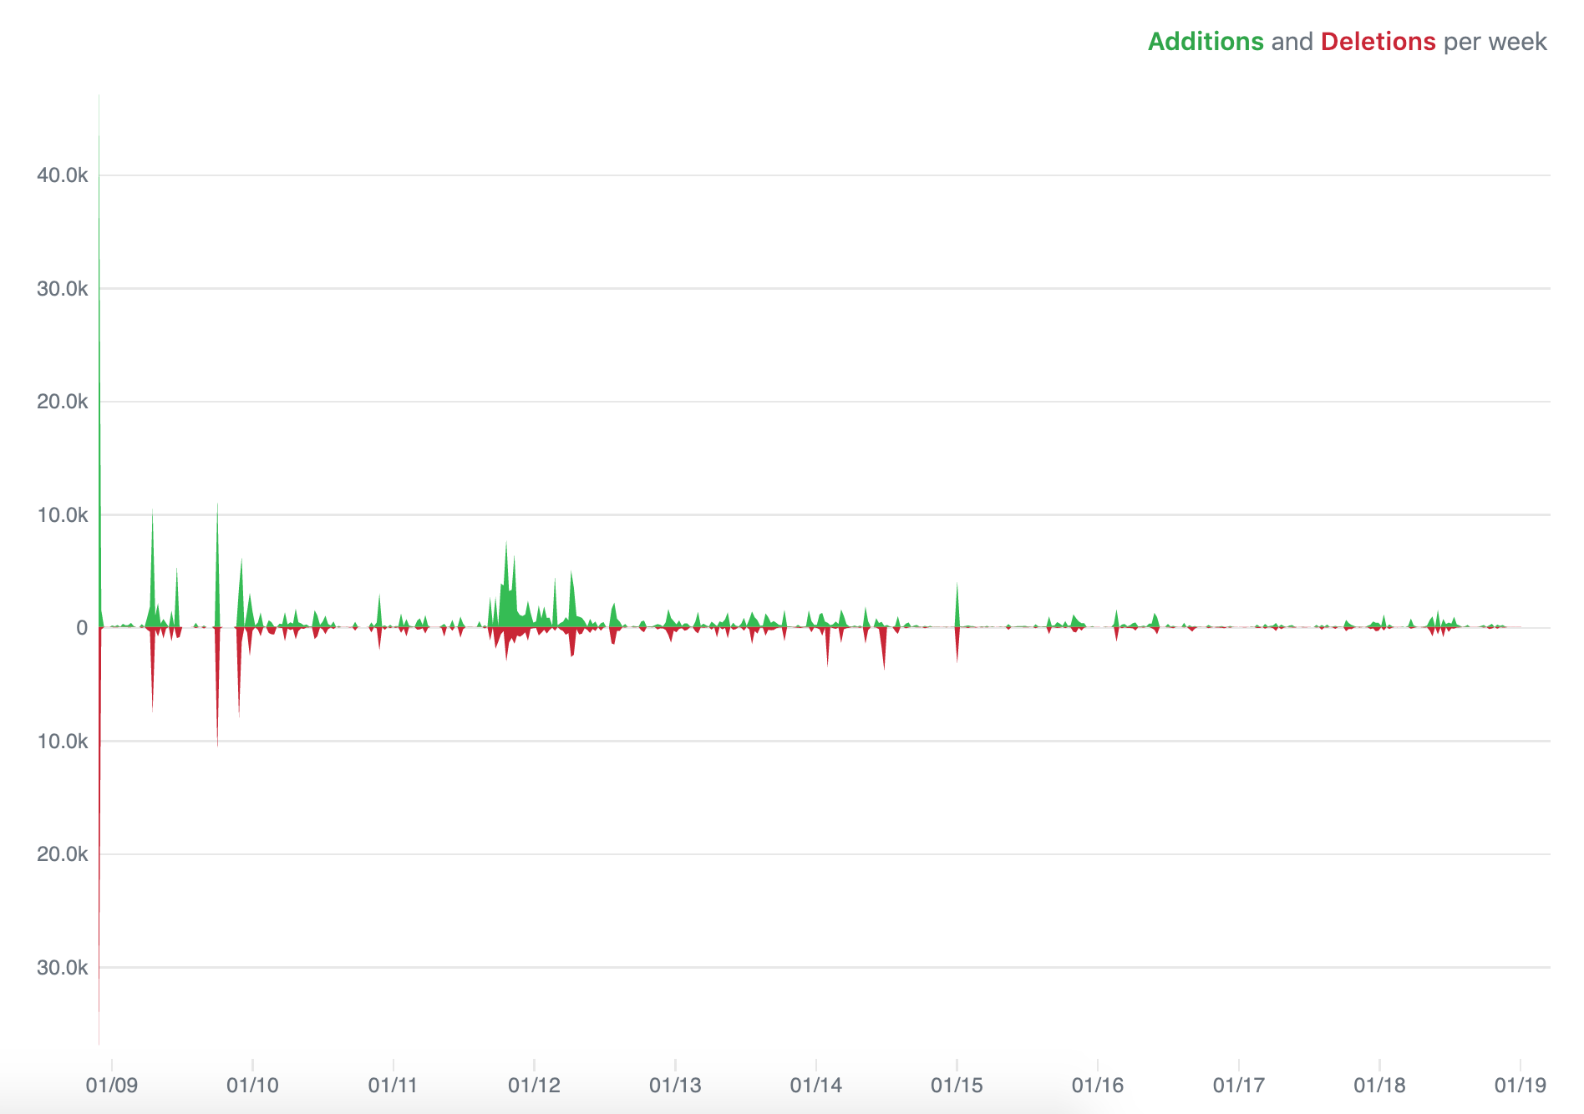
Scalaz

Slide 8

Cats

Slide 9
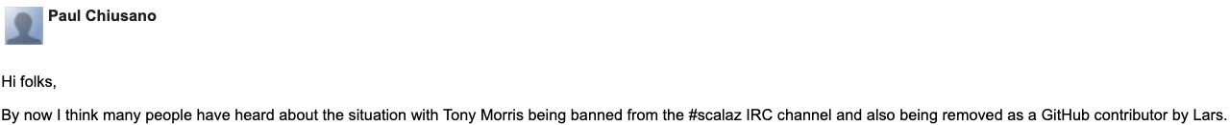
Unhappy ending story about Scalaz
Project stared by Tony before 2007 gathered a lot of contributors. Many of them are/was most known members of Scala community. One of them was Lars Hupel, who eventually became one of the most important contributors responsible for releases.
Somewhere around 2014 Lars banned Tony from channel he himself established.
Source: https://groups.google.com/forum/m/#!topic/scalaz/EBP_7sfB2ks
https://twitter.com/travisbrown/status/620444367145316353

Slide 10

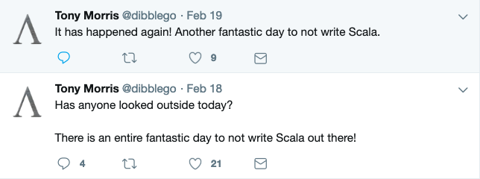
Tony Morris

Slide 11

Lars Hupel

Slide 12
Thanks for contribution
Bottom line is, Cats and Scalaz ecosystems fulfill the same role, and the only reason 2 of them exist in separation, is that relationship of some people core to the development broke down. It is also clear, that all the sides involved (no matter what they do now and how they feel about each other), had huge contribution the the community and current Scala would not be possible without them.

Slide 13
Problem
Future[A] comes up a lot in Scala.
You don’t want to block future, so you end up with Future everywhere.
Since Future is asynchronous, any errors need to be captured in there.
Future is designed to handle Throwable, but that’s all you get.
When the program becomes complex enough, you want to type your own error states.
How can we make Future of Either?

Slide 14
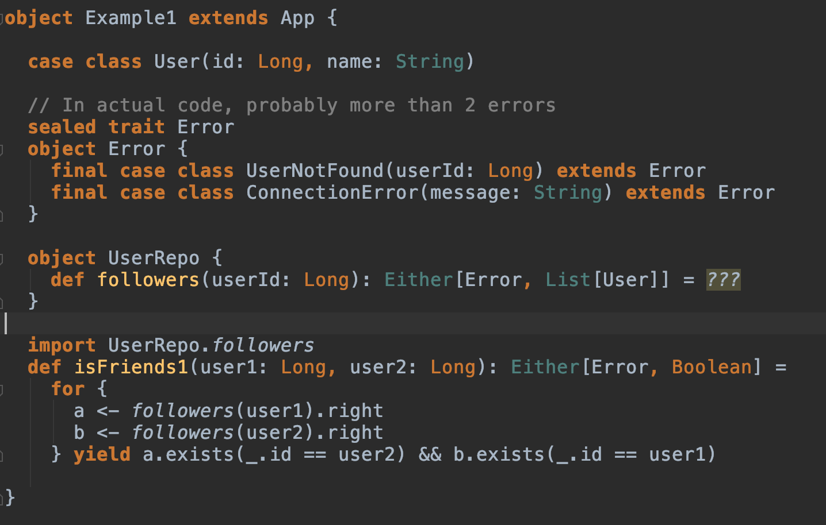
Example #1

Slide 15
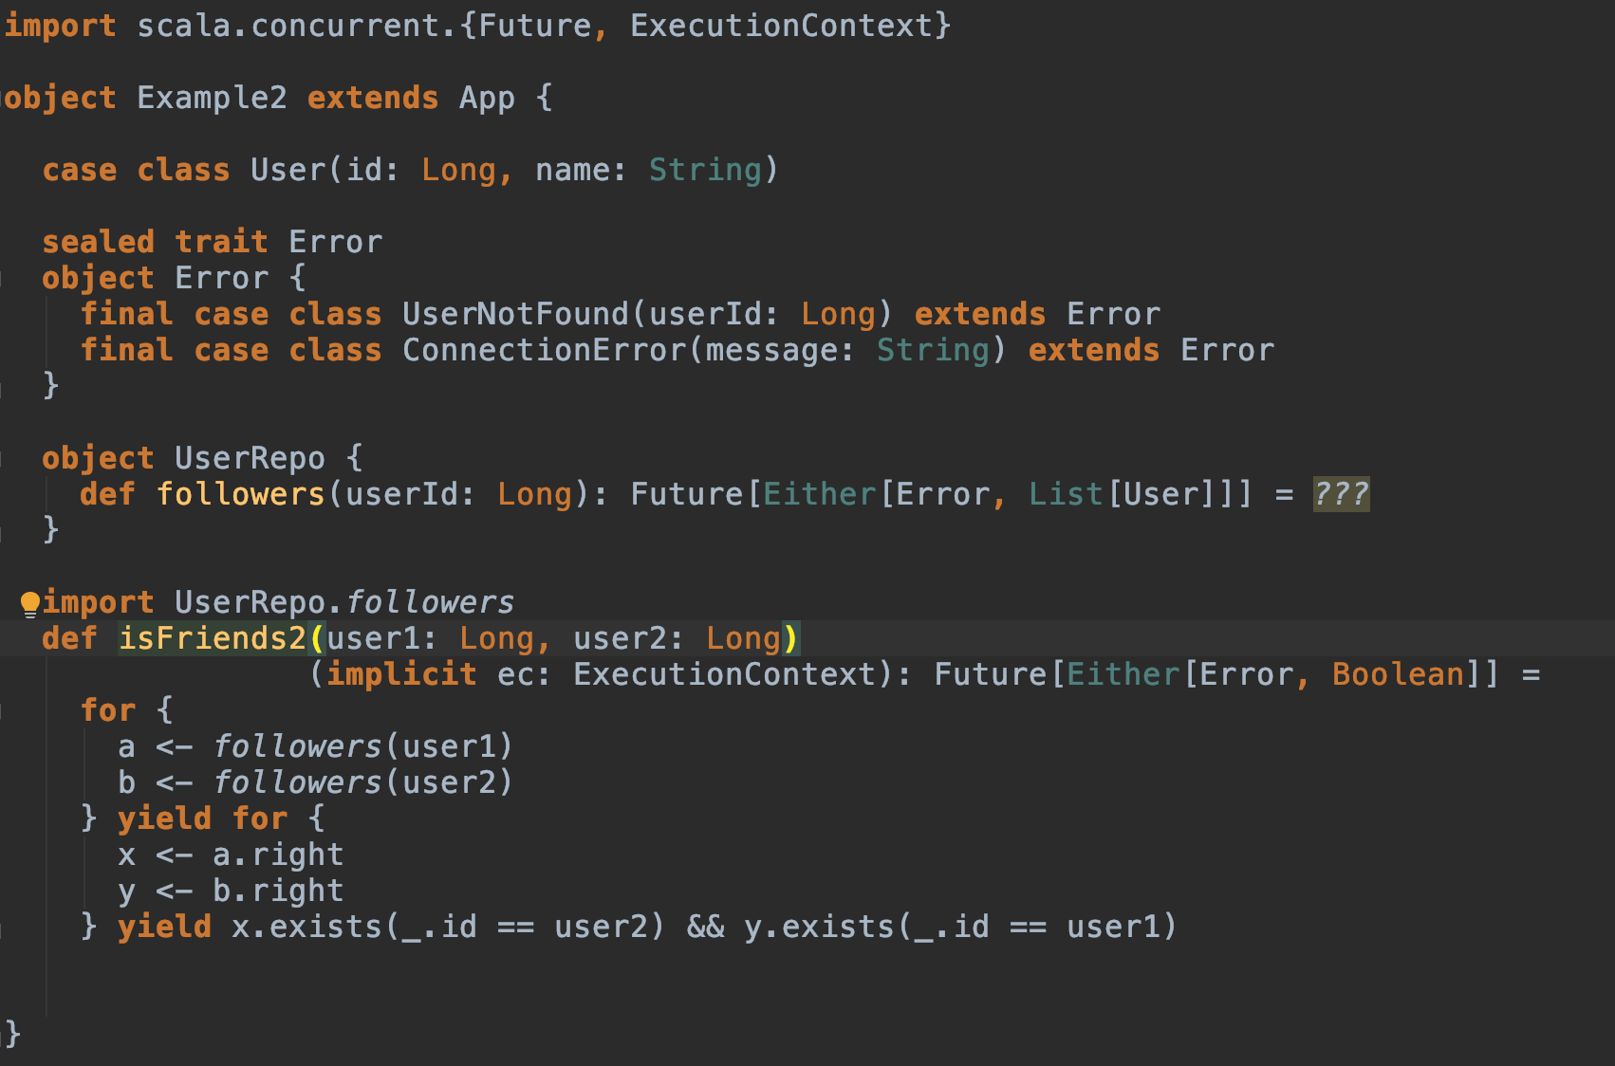
Example #2

Slide 16
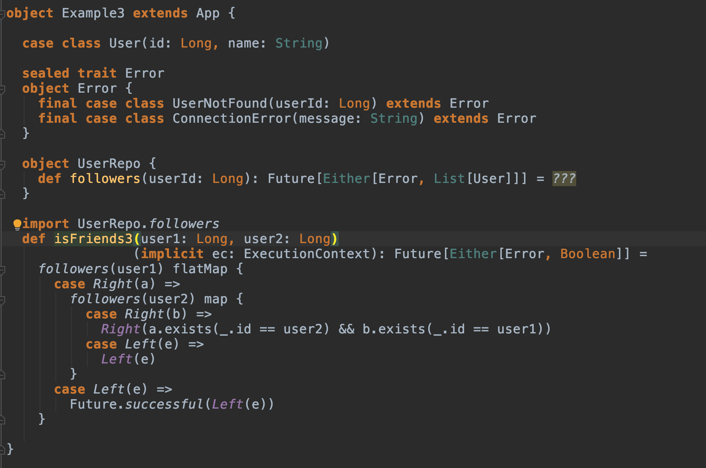
Example #3

Slide 17
Monad Transformers

Slide 18
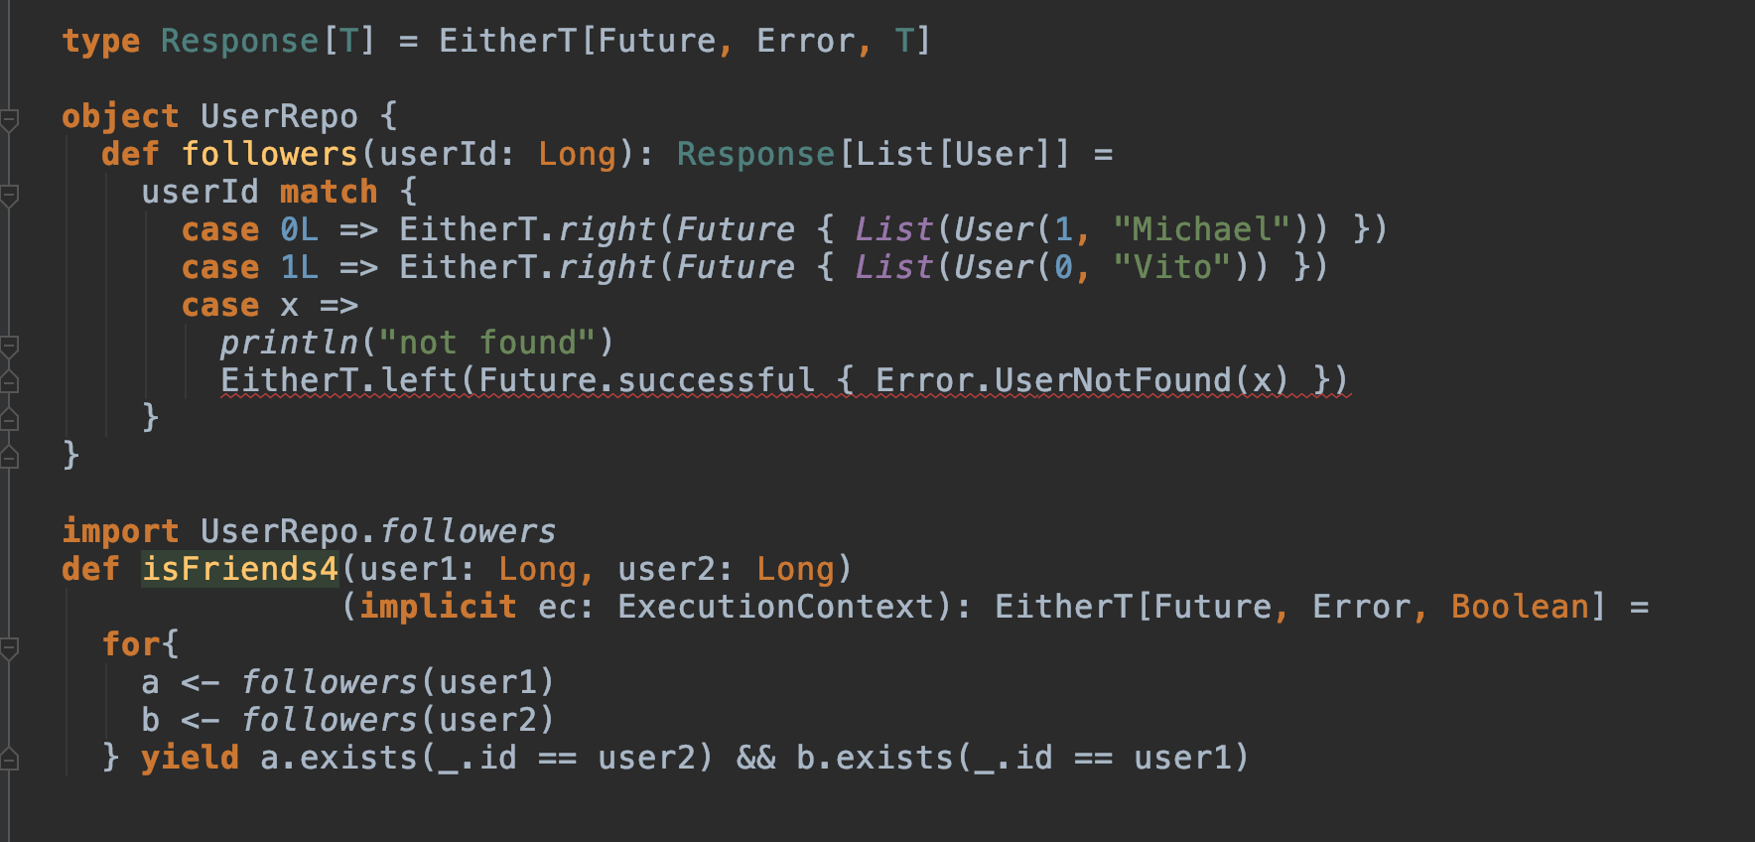
Example #4

Slide 19
Back to basics

Slide 20
Functor
trait Functor[F[_]] {
def map[A,B](fa: F[A])(f: A => B): F[B]
}
If you have been using Lists, Options, Eithers, Futures in Scala, you have been using functors.

Slide 21
Functor

Slide 22
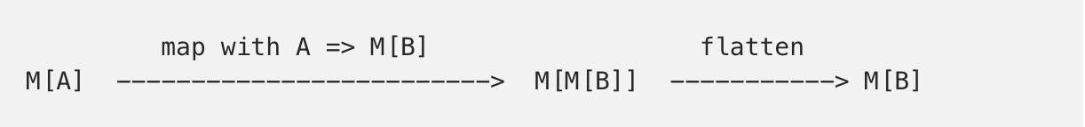
Monad
flatMap: (A => M[B]) => M[B]

Slide 23
Monads in Cats
trait Monad[F[_]] {
def pure[A](a: A): F[A]
def flatMap[A, B](fa: F[A])(f: A => F[B]): F[B]
def map[A, B](fa: F[A])(f: A => B): F[B] = {
flatMap(fa)(a => pure(f(a)))
}
}

Slide 24
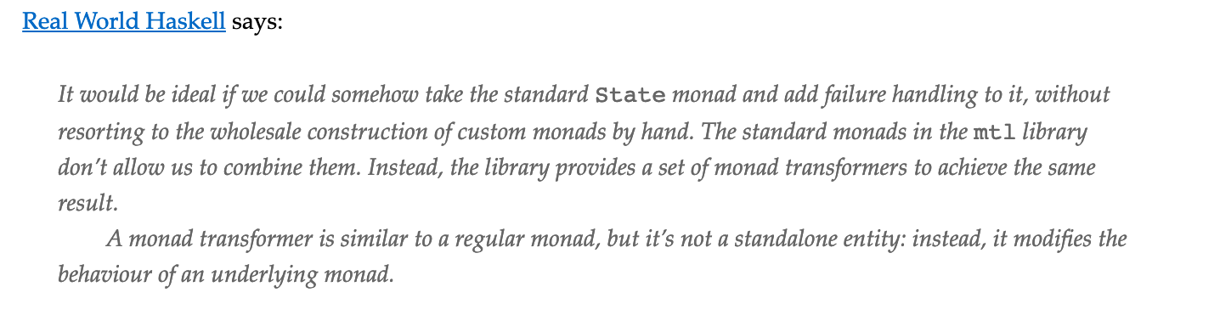
Monad transformers

Slide 25
Monad Transformers in Cats
cats.data.OptionT for Option;
cats.data.EitherT for Either;
cats.data.ReaderT for Reader;
cats.data.WriterT for Writer;
cats.data.StateT for State;
cats.data.IdT for the Id monad.

Slide 26
THANK YOU

Slide 27
Links
trait Monad[F[_]] {
def pure[A](a: A): F[A]
def flatMap[A, B](fa: F[A])(f: A => F[B]): F[B]
def map[A, B](fa: F[A])(f: A => B): F[B] = {
flatMap(fa)(a => pure(f(a)))
}
}

